Slide 1

David M. Kroenke and David J. Auer Database Processing: Fundamentals, Design, and Implementation
Chapter Ten A:
Managing Databases with
SQL Server 2014
Part 2: SQL DDL, DML and SQL/PSM

Slide 2
Chapter Objectives
To install SQL Server 2014
To use SQL Server 2014’s graphical utilities
To create a database in SQL Server 2014
To submit both SQL DDL and DML via the Microsoft SQL Server Management Studio
To import Microsoft Excel worksheet data into a database table
To understand the use of SQL/Persistent Stored Modules (SQL/PSM) in Microsoft Transact-SQL
To understand the purpose and role of user-defined functions and know how to create simple user-defined functions

Slide 3
Chapter Objectives
To understand the purpose and role of stored procedures and know how to create simple stored procedures
To understand the purpose and role of triggers and know how to create simple triggers
To understand how SQL Server implements indexes, concurrency control and cursors
To understand the SQL Server security model
To understand the fundamental features of SQL Server backup and recovery facilities

Slide 4
Scope
The PowerPoint slide show covers the last nine objectives.
In particular:
How to use SQL DDL to create and populate an SQL Server 2014 database.
How to import Microsoft Excel data into an SQL Server 2014 database.
How to use SQL/PSM to create user-defined functions, stored procedures and triggers

Slide 5

View Ridge Gallery

Slide 6
View Ridge Gallery
View Ridge Gallery is a small art gallery that has been in business for 30 years.
It sells contemporary European and North American fine art.
View Ridge has one owner, three salespeople, and two workers.
View Ridge owns all of the art that it sells; it holds no items on a consignment basis.

Slide 7
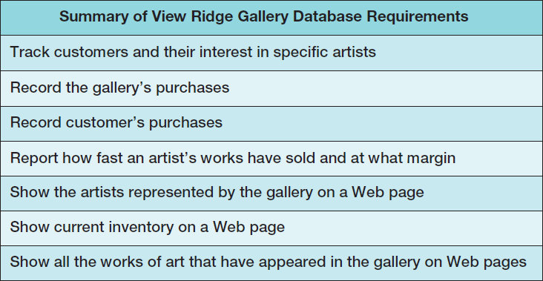
VRG Application Requirements

Slide 8
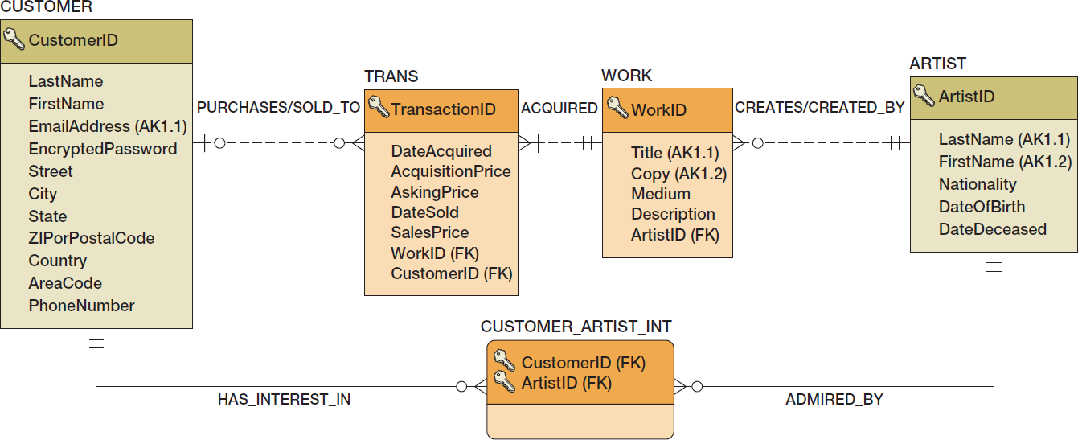
VRG Database Design

Slide 9
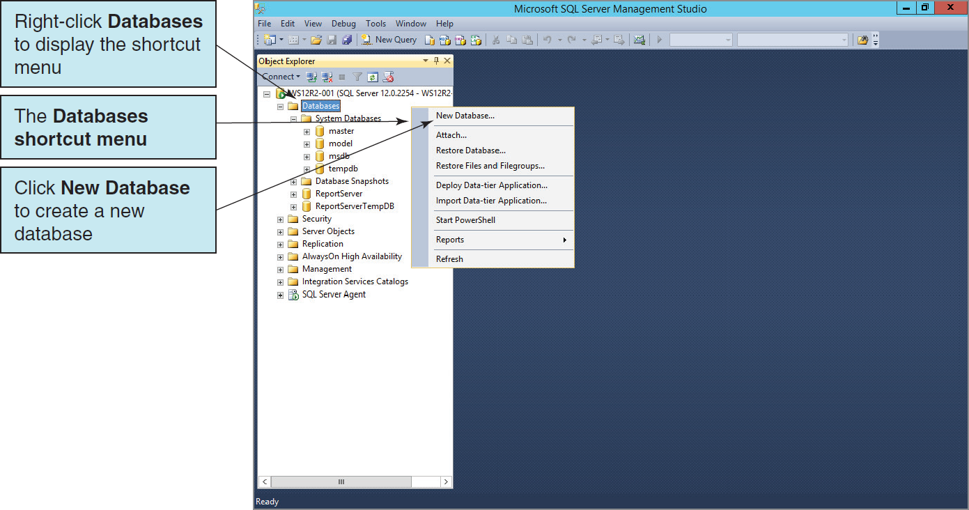
Creating the VRG Database

Slide 10
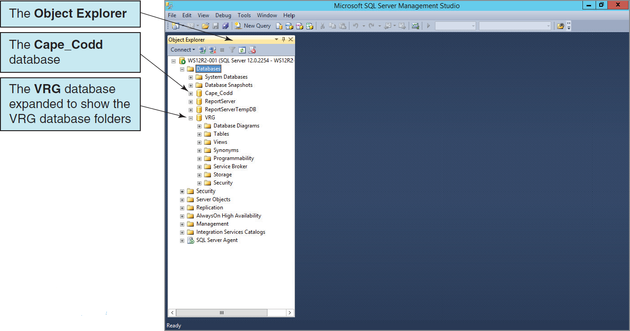
The VRG Database in the Object Explorer

Slide 11
SQL Scripts
An SQL script is a plaintext file labeled with the .sql file extension.
An SQL script is composed of one or more SQL statements, which can include SQL script comments.
SQL script comments are lines of text that do not run when the script is executed but are used to document the purpose and contents of the script. Each comment begins with the characters /* (slash asterisk) and ends with the characters */ (asterisk slash). Alternatively, for a single line comment (or a comment at the end of a line), we use – – (two dashes) at the start of the comment.

Slide 12
VRG Database Available Online
The SQL scripts to create and populate the VRG database tables are complex scripts and tedious to reproduce in their complete form.
Versions of the SQL scripts for the complete VRG database are available in the downloadable Student Files available at:
http://www.pearsonhighered.com/kroenke/
These include versions for:
Microsoft SQL Server 2014
Oracle Database 12c and Oracle Database XE
MySQL 5.6
We recommend you actually run all material in a live database!

Slide 13
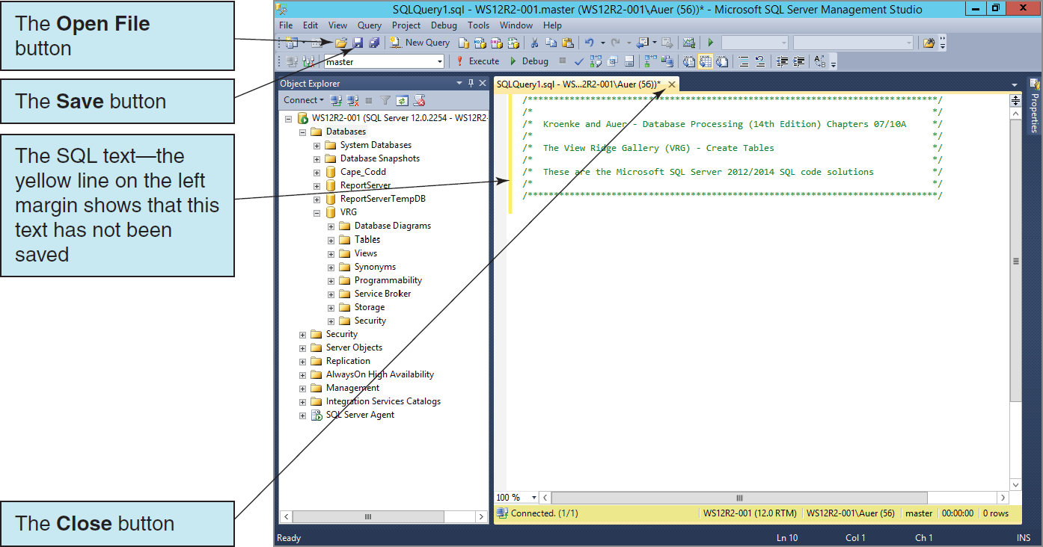
Entering SQL Statements in the SQL Editor

Slide 14
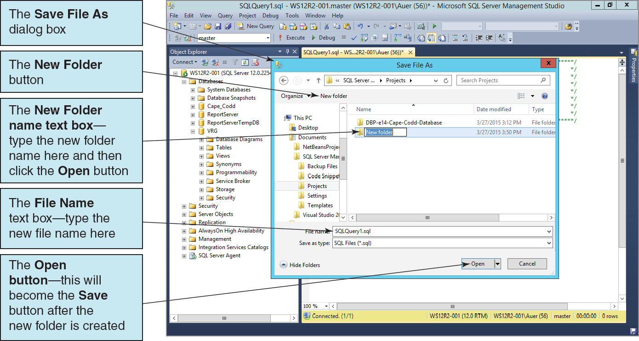
Saving the SQL Script in a New Folder

Slide 15
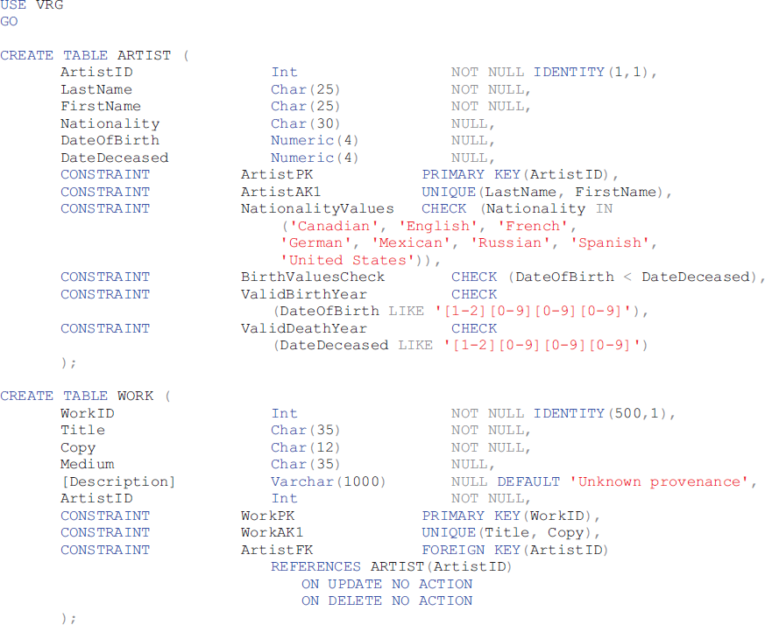
SQL Server CREATE TABLE Statements for the VRG Database I

Slide 16
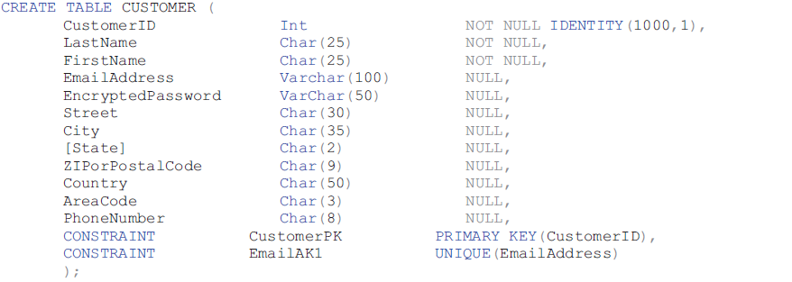
SQL Server CREATE TABLE Statements for the VRG Database II

Slide 17
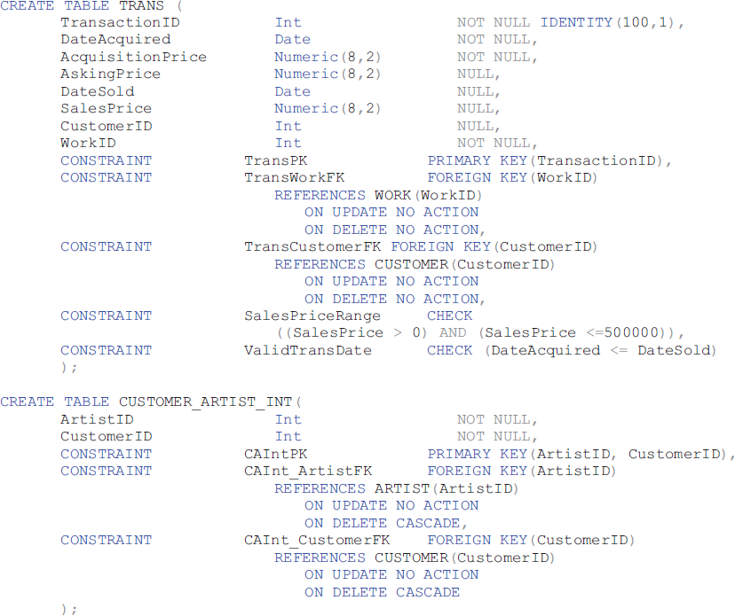
SQL Server CREATE TABLE Statements for the VRG Database III

Slide 18
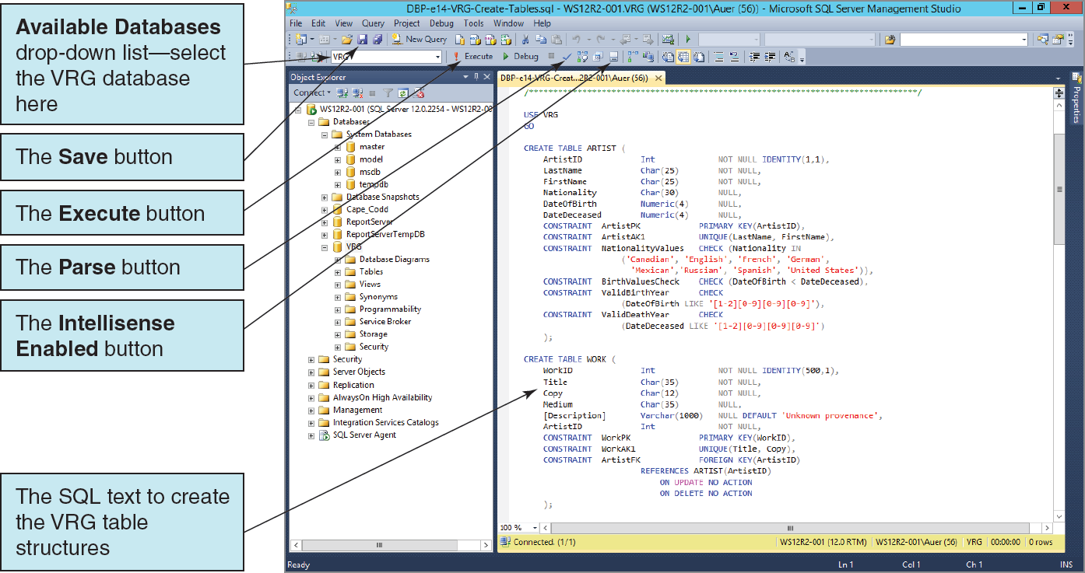
SQL Server CREATE TABLE Statements Running the Script

Slide 19
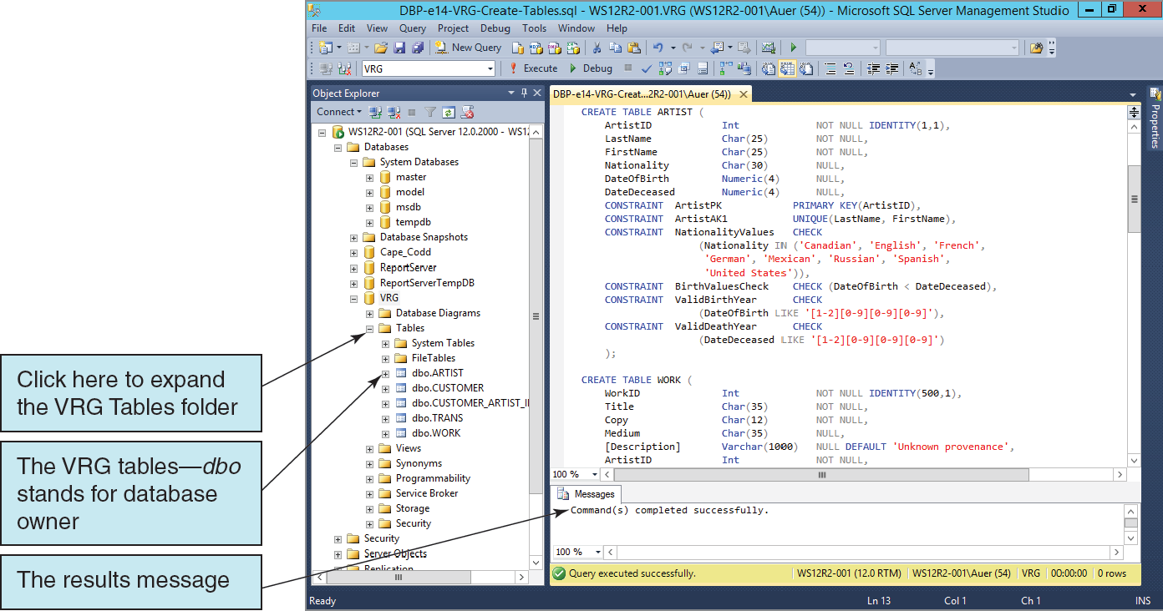
SQL Server CREATE TABLE Statements The Created Tables
Notes:
The dbo in this figure stands for database owner. This is the name of the default SQL Server schema, which is a named collection of database 0bjects—think of a schema as a container that holds database objects such as tables and views. SQL Server schemas are part of SQL Server security model, which we dis- cuss in detail later in this chapter. SQL Server treats the schema name as part of the object name, which is why the ARTIST table appears in this figure as dbo.ARTIST.
For now, just understand that if you installed SQL Server 2014 and created the VRG database, you are the owner of the dbo schema and of any database objects that are contained in the dbo schema.

Slide 20
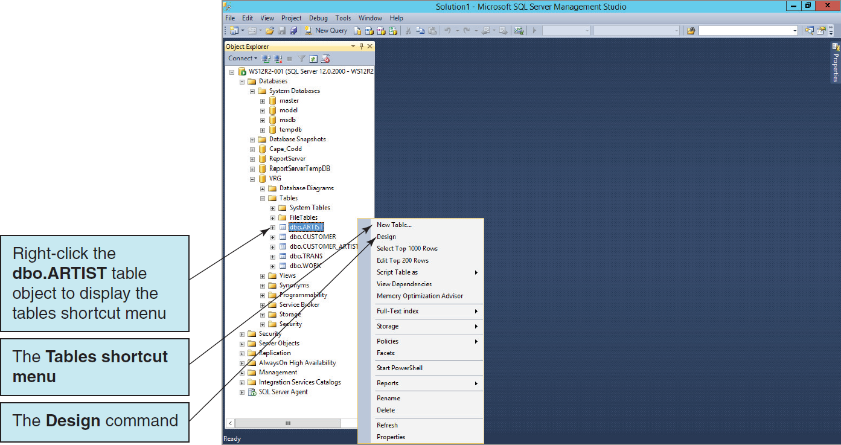
Viewing Tables in the Microsoft SQL Server Management Studio I

Slide 21
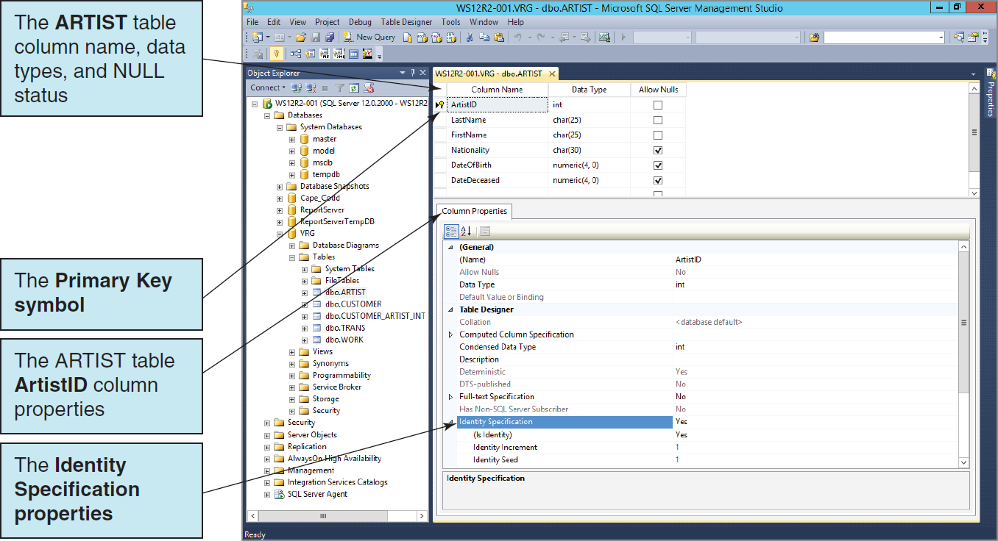
The ARTIST Table Columns and Column Properties

Slide 22
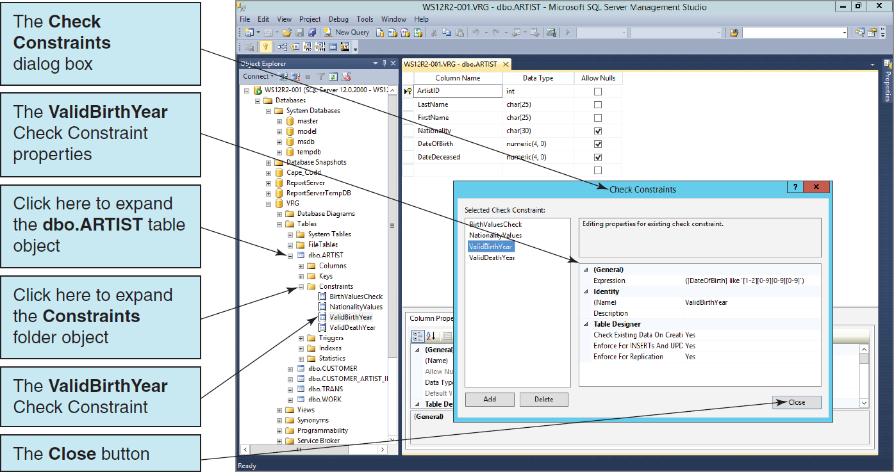
The ARTIST Table Check Constraints

Slide 23
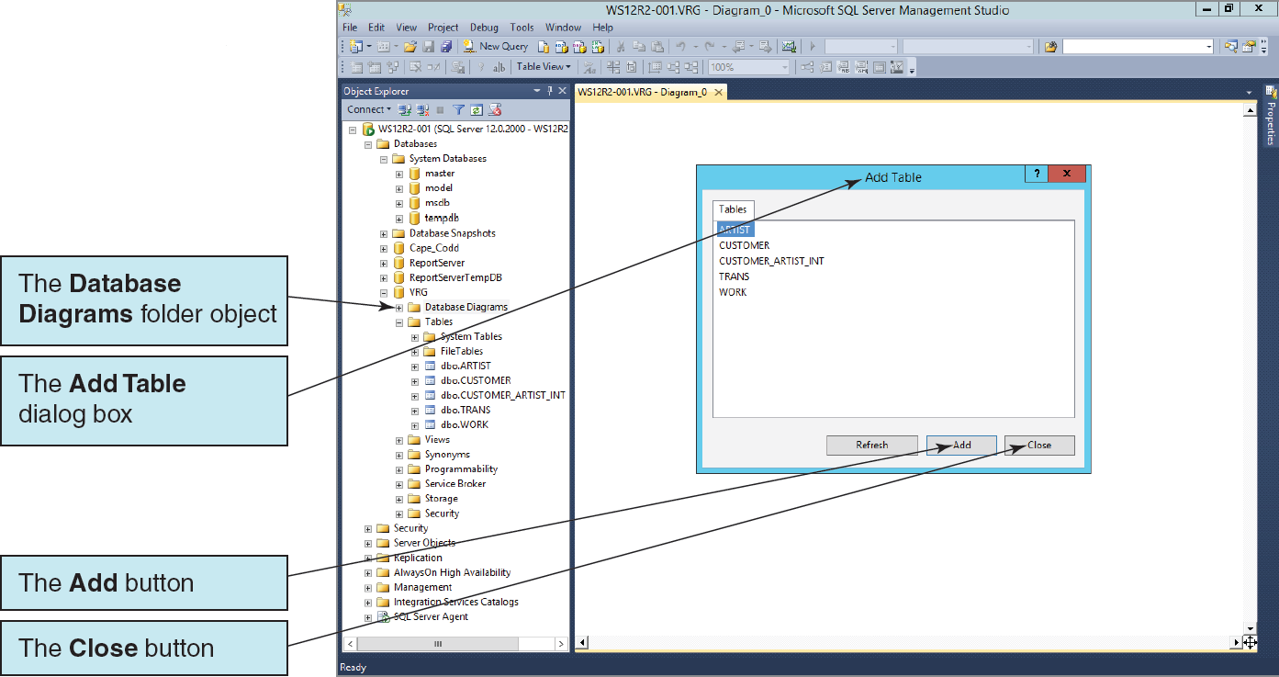
Database Diagrams The Add Table Dialog Box

Slide 24
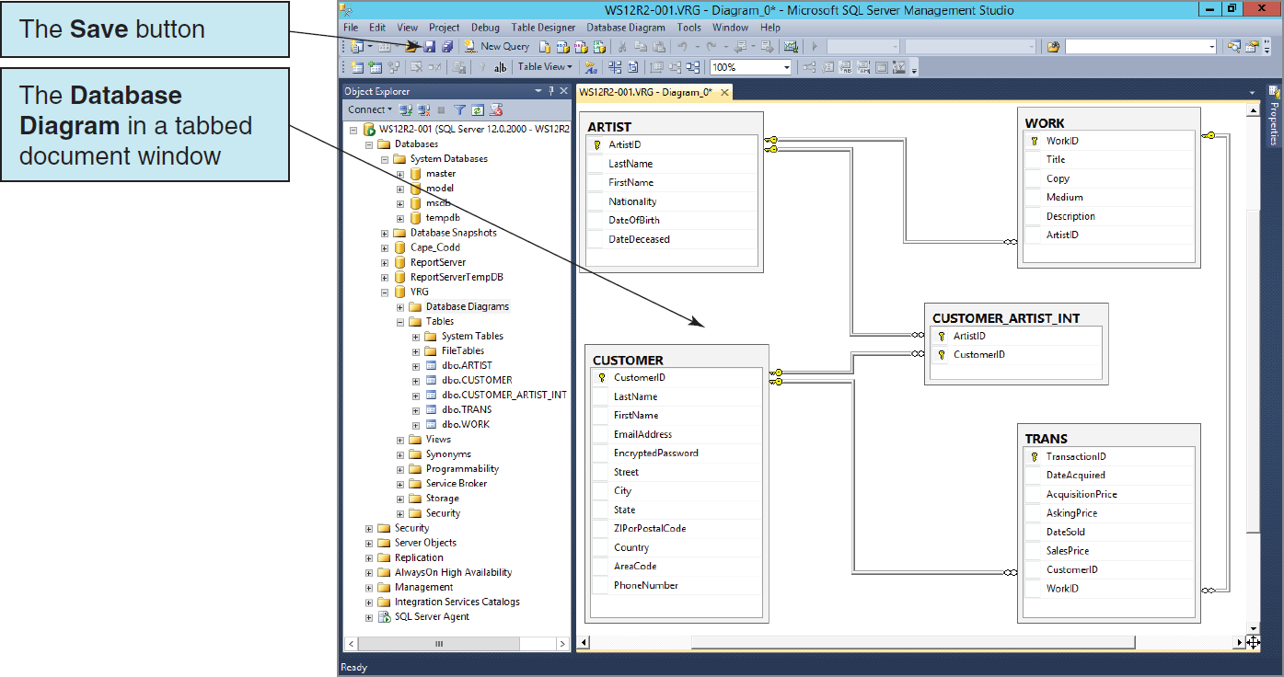
Database Diagrams The VRG Database Diagram

Slide 25
Database Diagrams What are They?
What exactly is a database diagram? Let us be very clear not only about what it is but also about what it isn’t.
What a database design is not:
It is not a data model (Chapter 5).
It is not in data model E-R notation
It is not used to determine user requirements.
It is not a database design (Chapter 6).
It is not in database design E-R notation
It is not used as a component design.

Slide 26
Database Diagrams What are They (continued)?
What a database diagram is: It is a visual representation of the database as it has been actually created in SQL server.
It is used to help visualize and inspect the database.
It does indicate primary keys.
It does not indicate foreign keys.
It does show relationships and which table contains the foreign key and the corresponding primary key, but it does not visually connect these fields.

Slide 27
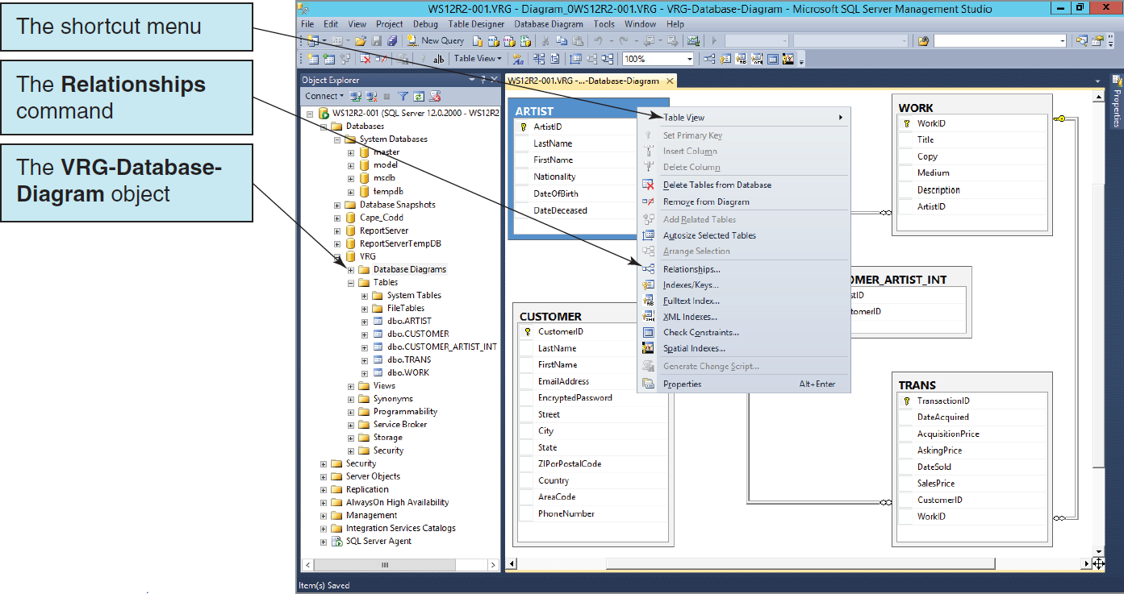
Database Diagrams The Database Diagram Table Shortcut Menu

Slide 28
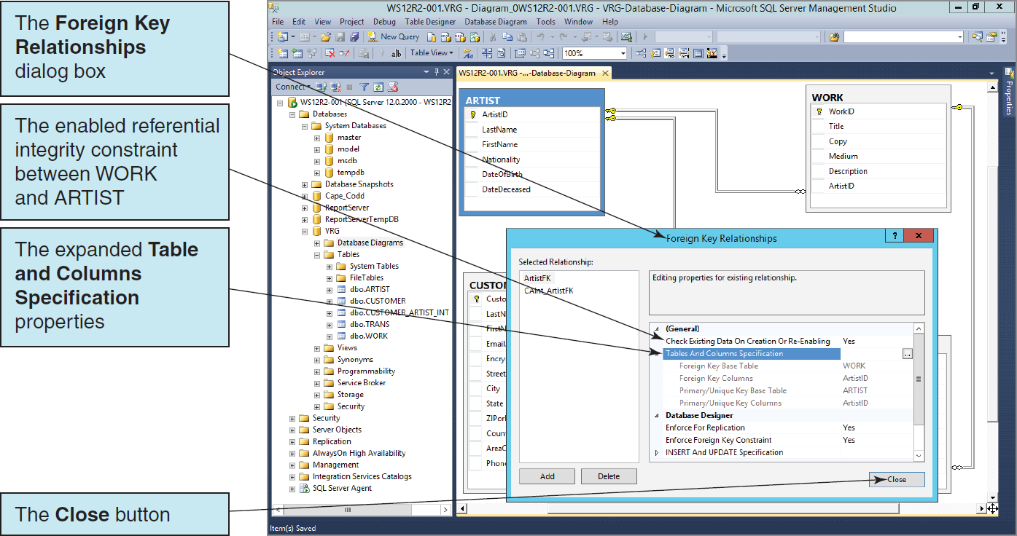
Database Diagrams The Foreign Key Relationships Dialog Box

Slide 29
Indexes
Indexes are special data structures used to improve database performance.
SQL Server automatically creates an index on all primary and foreign keys.
Additional indexes may be assigned on other columns that are:
Frequently used in WHERE clauses.
Used for sorting data.

Slide 30
Indexes
SQL Server supports two kinds of indexes:
Clustered index: the data are stored in the bottom level of the index and in the same order as that index
Nonclustered index: the bottom level of an index contains pointers to the data
Clustered indexes are faster than nonclustered indexes for updating and retrieval.

Slide 31
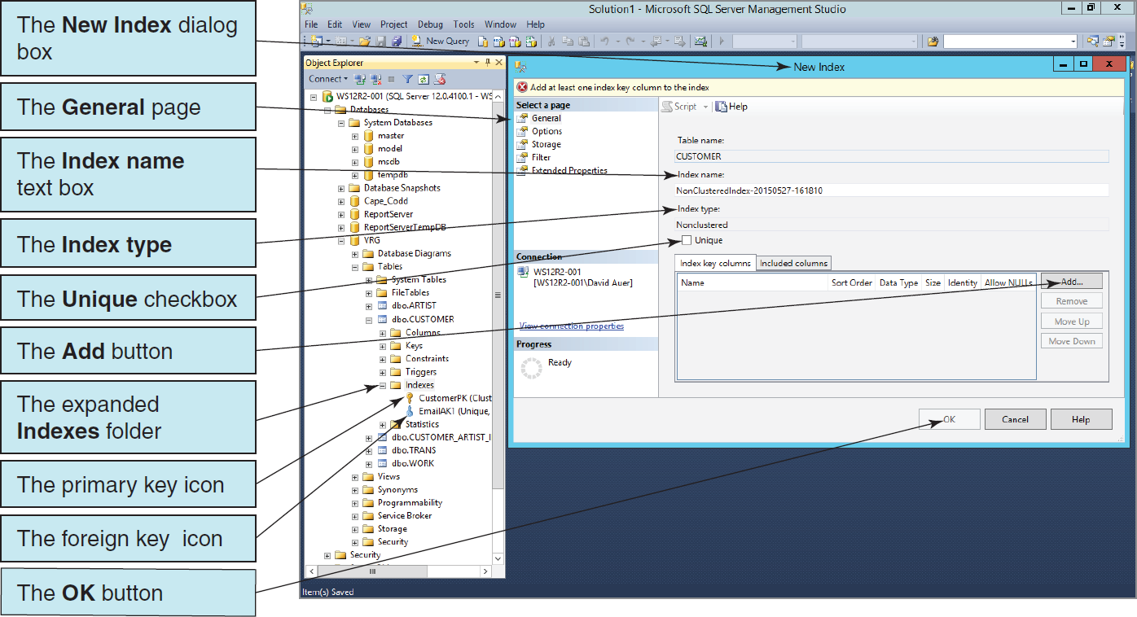
Creating an Index The New Index Dialog Box

Slide 32
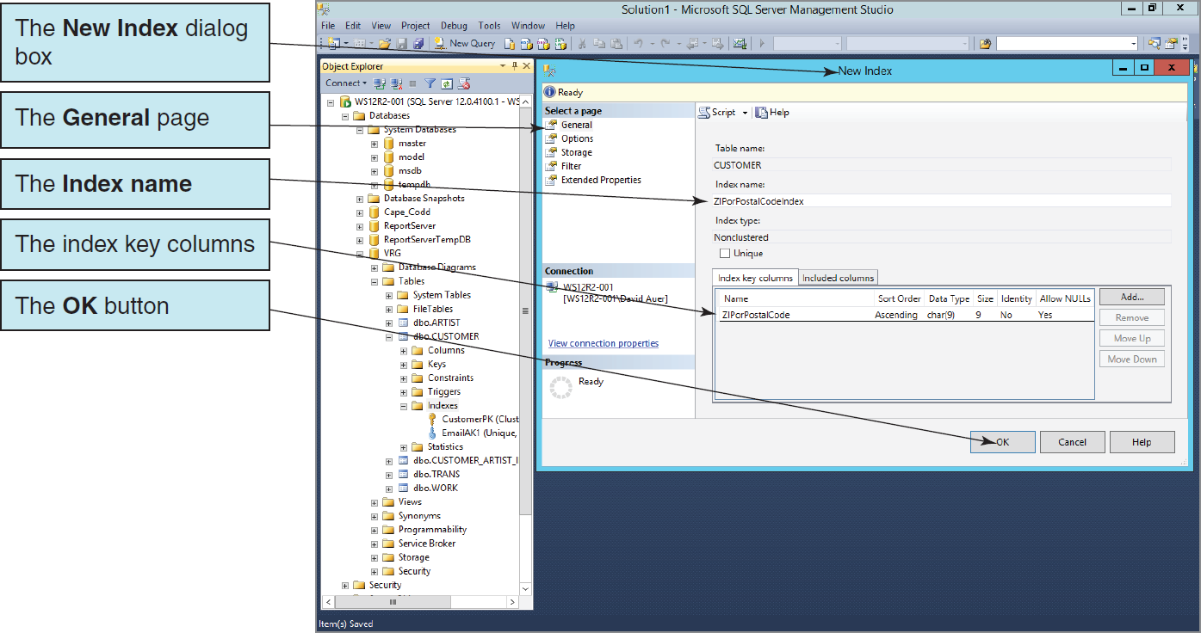
Creating an Index The Completed New Index Dialog Box

Slide 33
Populating the Tables: The IDENTITY Keyword
The IDENTITY keyword implements a new constraint for surrogate keys.
IDENTITY (m, n) creates a surrogate key with an Identity Seed (StartValue) of m and an Identity Increment of n:
CREATE TABLE CUSTOMER(
CustomerID int NOT NULL IDENTITY (1000,1),
Name char(25) NOT NULL,
CONSTRAINT CustomerPK PRIMARY KEY (CustomerID),
CONSTRAINT CustomerAK1 UNIQUE (Name)
);

Slide 34
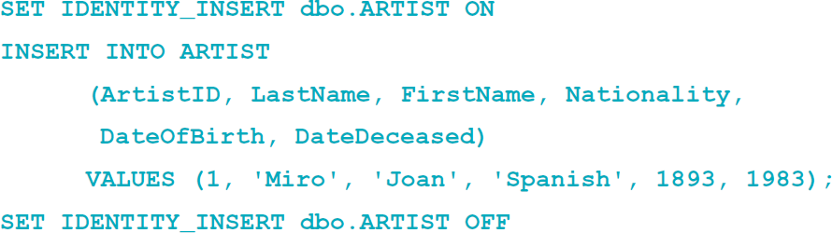
Populating the Tables: The IDENTITY_INSERT Property
The VRG database data has existing non-continuous primary key surrogate key values.
The IDENTITY_INSERT property allows the insertion on non-continuous surrogate key values.

Slide 35
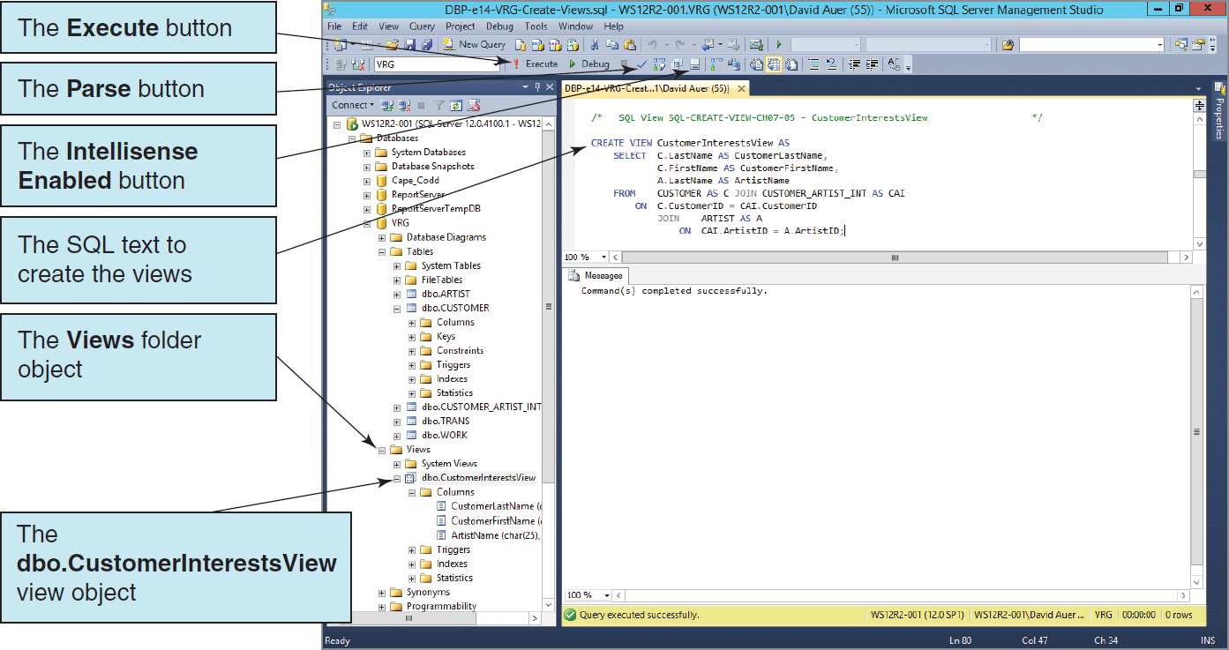
SQL Views Creating an SQL View

Slide 36
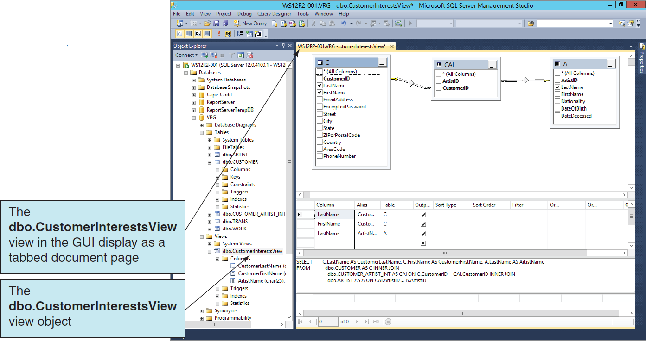
SQL Views Viewing an SQL View in the GUI Display

Slide 37
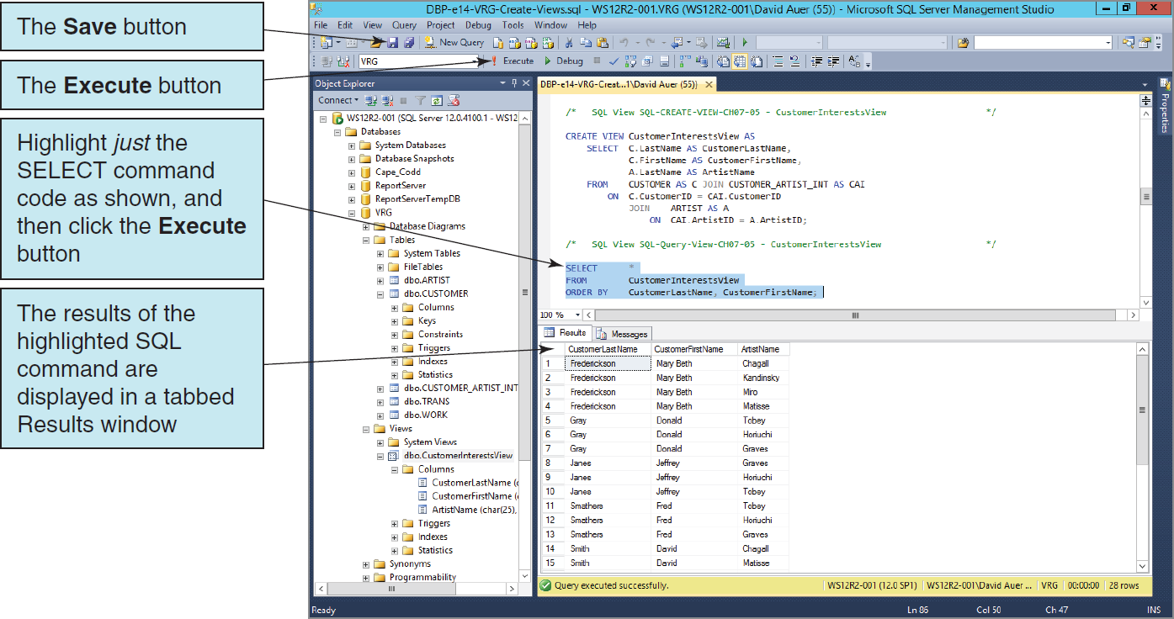
SQL Views Using an SQL View in an SQL SELECT Statement

Slide 38
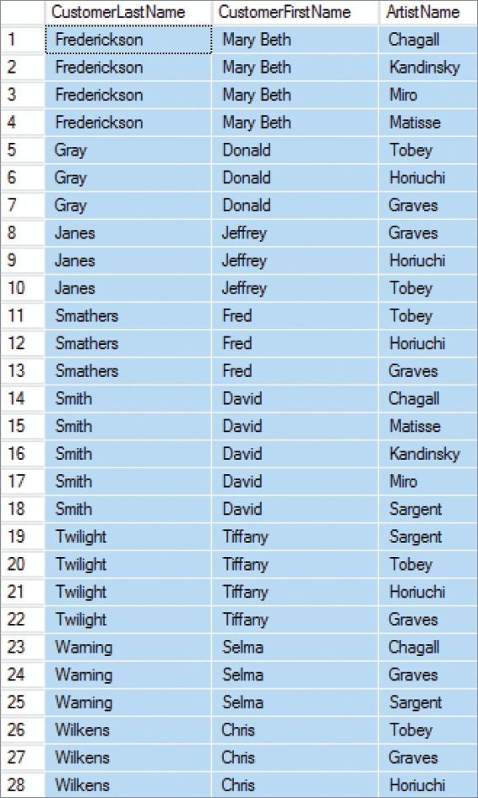
SQL Views Complete SQL SELECT Statement Results

Slide 39
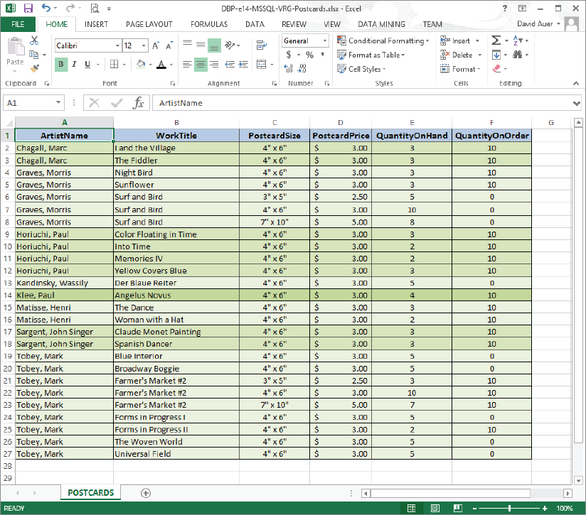
Importing Microsoft Excel Data The View Ridge Gallery POSTCARD Worksheet
This worksheet is included in the downloadable Student Files available at: http://www.pearsonhighered.com/kroenke/
Notes:
Apparently the SQL Server Import and Export Wizard is only programmed to work with Microsoft Excel workbooks thorough Microsoft Excel 2007. Even though we are using Microsoft Excel 2013, we have to download and install the 2007 Office System Driver: Data Connectivity Components from http://www.microsoft.com/en-us/download/details.aspx?id=23734 .
If you don’t install this software, you will get an error message during the Wizard, and it will not complete its tasks.

Slide 40
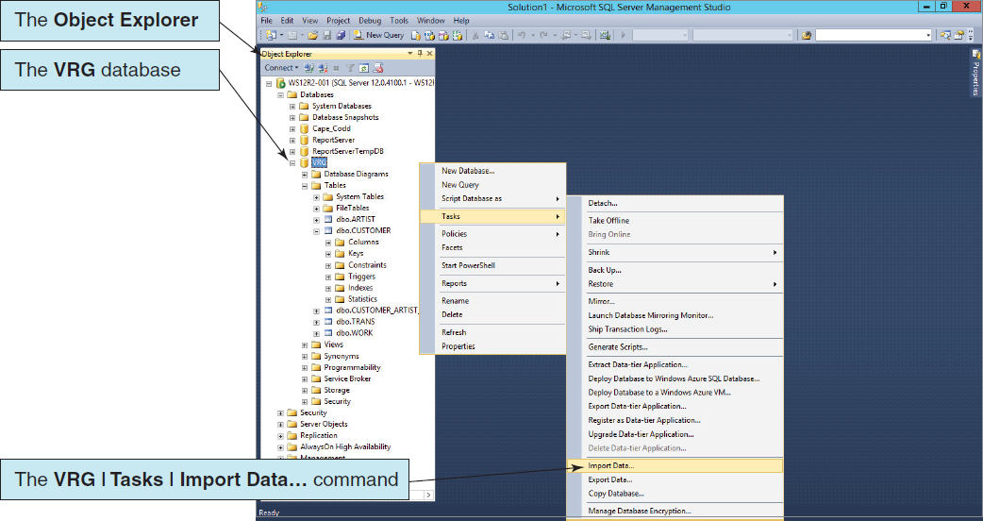
Importing Microsoft Excel Data Launching the Microsoft SQL Server Import and Export Wizard

Slide 41
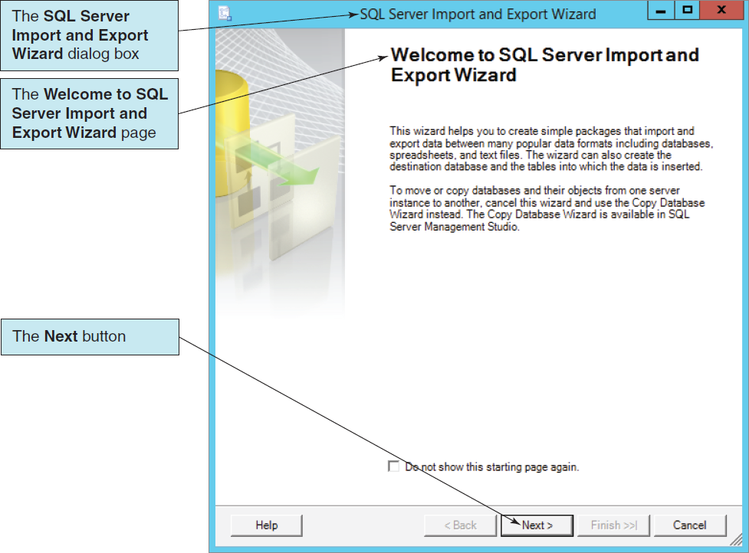
Importing Microsoft Excel Data The Microsoft SQL Server Import and Export Wizard

Slide 42
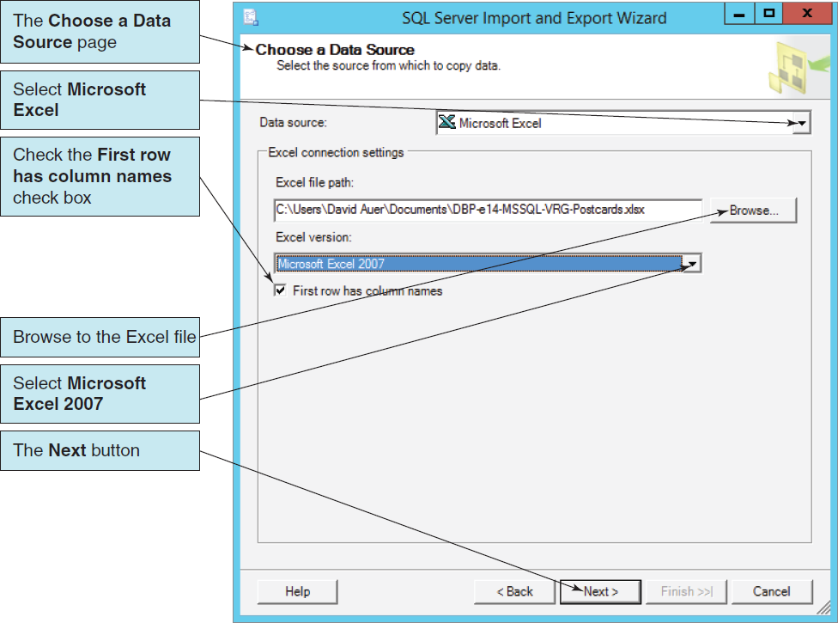
Importing Microsoft Excel Data The Choose a Data Source Page

Slide 43
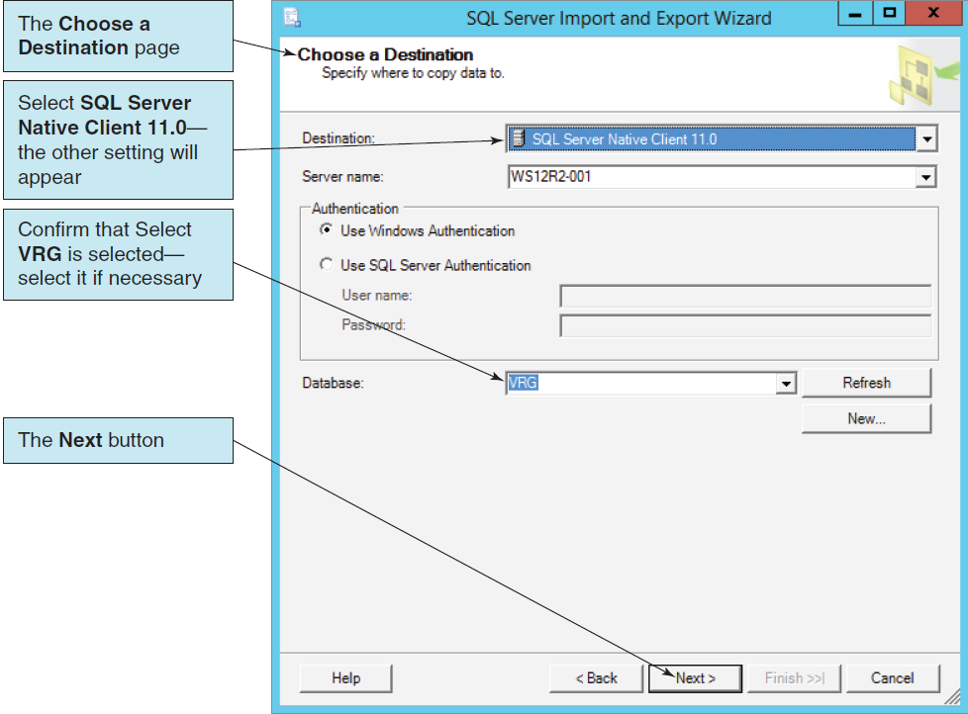
Importing Microsoft Excel Data The Choose a Destination Page

Slide 44
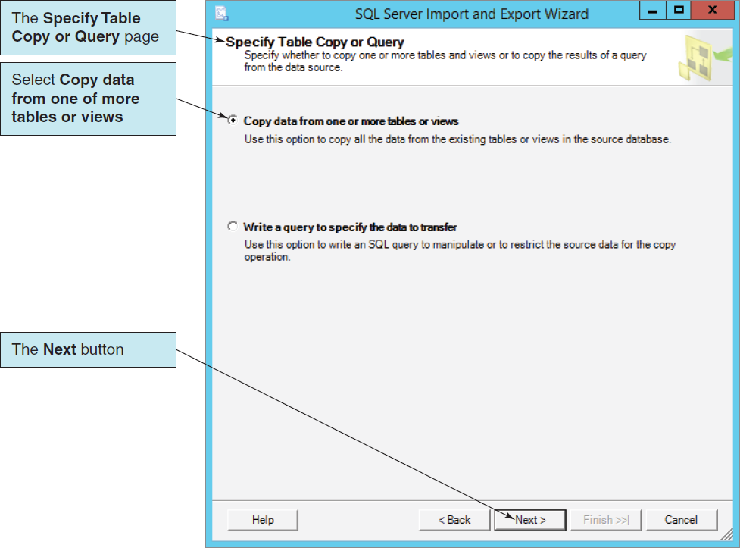
Importing Microsoft Excel Data The Specify Table Copy or Query Page

Slide 45
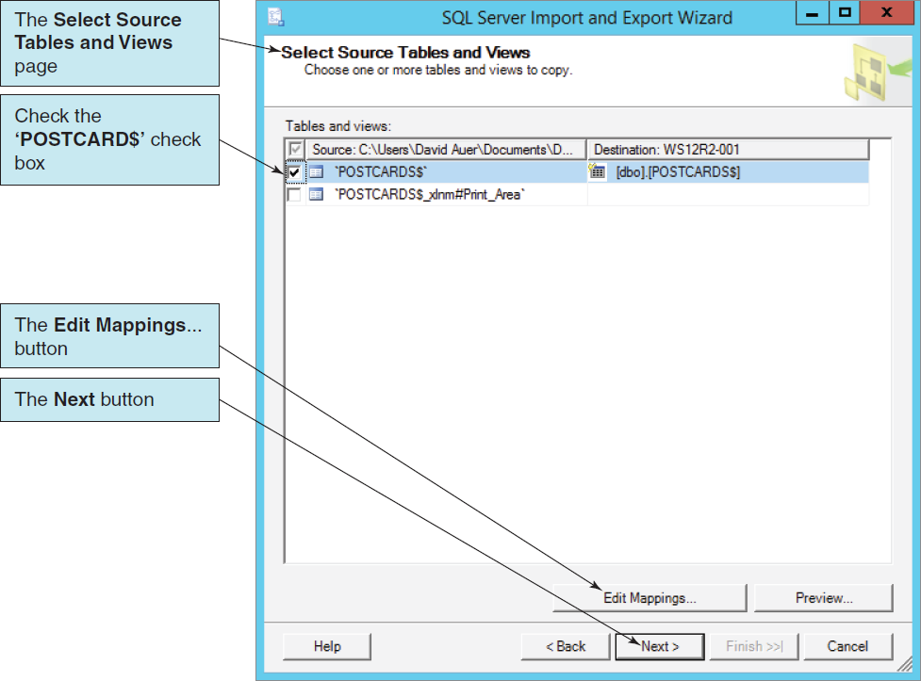
Importing Microsoft Excel Data The Select Source Tables and Views Page

Slide 46
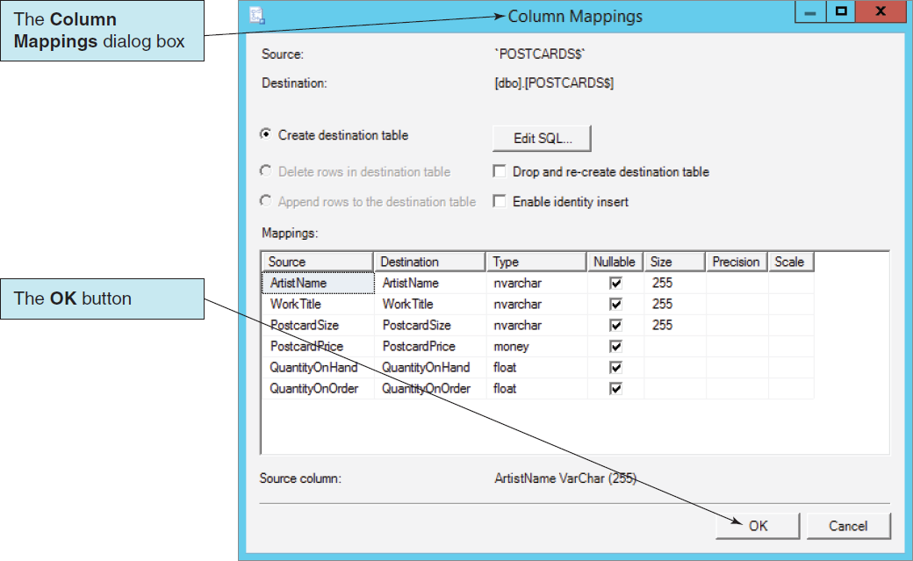
Importing Microsoft Excel Data The Column Mappings Dialog Box

Slide 47
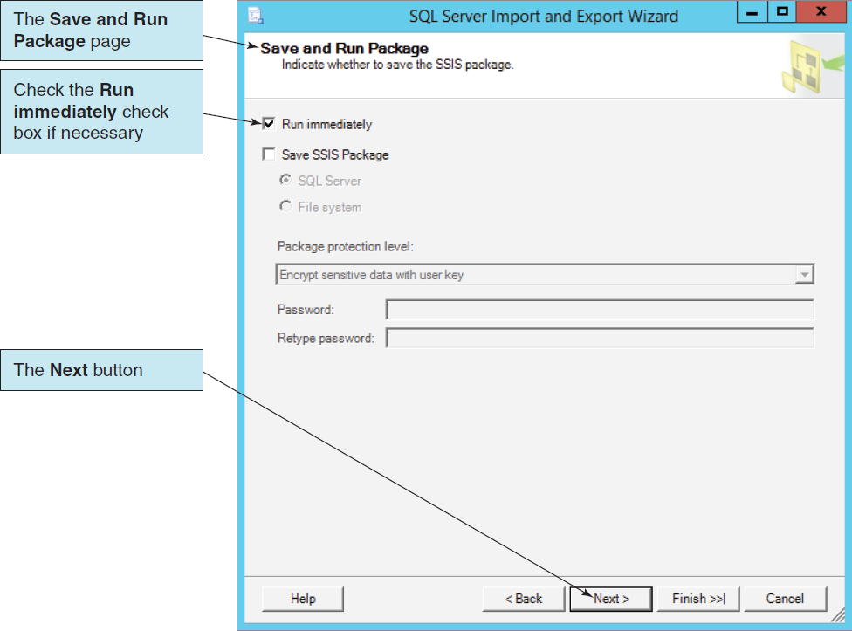
Importing Microsoft Excel Data The Save and Run Package Page

Slide 48
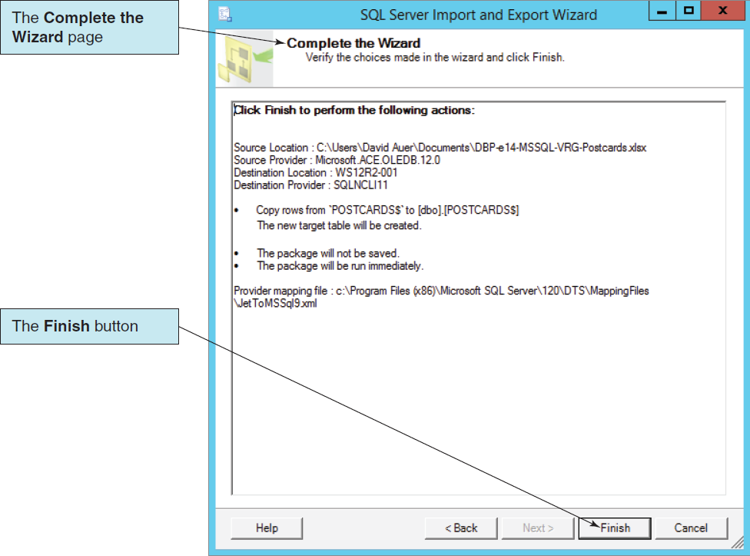
Importing Microsoft Excel Data The Complete the Wizard Page

Slide 49
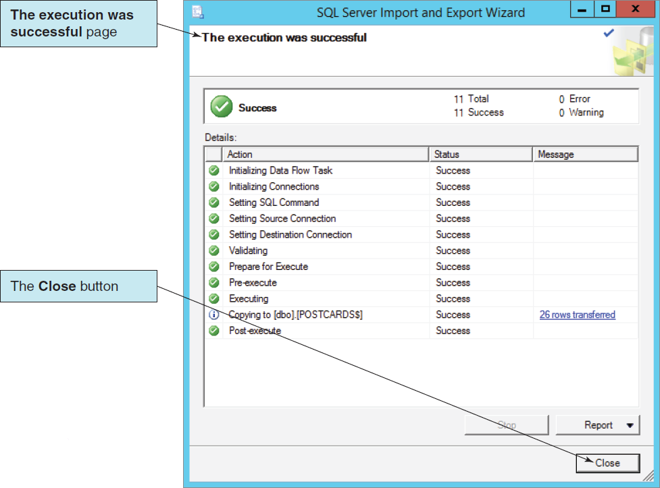
Importing Microsoft Excel Data The Execution was Successful Page

Slide 50
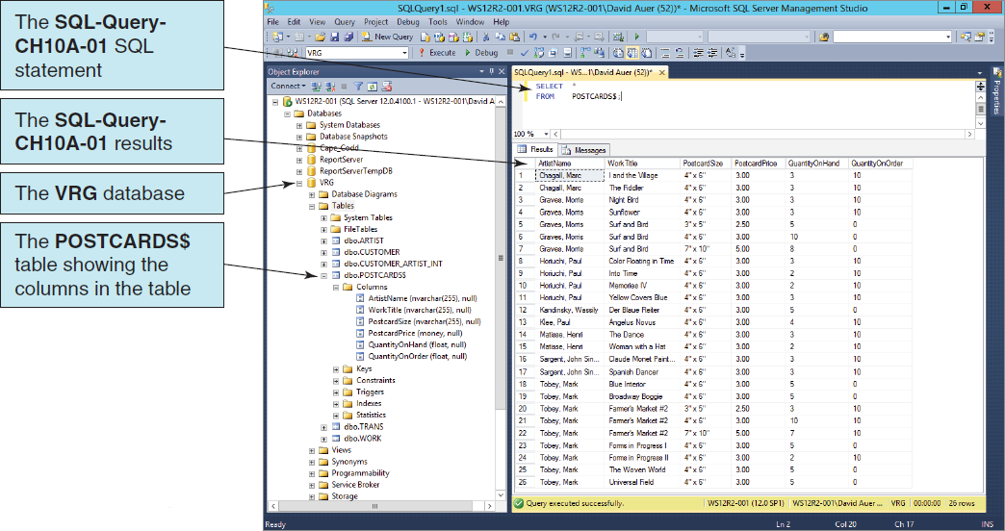
Importing Microsoft Excel Data The Microsoft Excel Data in the POSTCARD$ Table

Slide 51
Application Logic I
SQL Server database applications can be processed using:
A programming language, e.g., C# .NET, C++. NET, Visual Basic.NET, to invoke SQL Server DBMS commands
PowerShell and the sqlps utility to invoke database commands stored in .sql files
The Microsoft SQL Server Management Studio to invoke database commands stored in .sql files
Stored procedures
Triggers

Slide 52
Application Logic II
SQL Server implements a version of the standard SQL/Persistent Stored Modules (SQL/PSM)
SQL Server’s variant is called Transact-SQL (T-SQL)

Slide 53
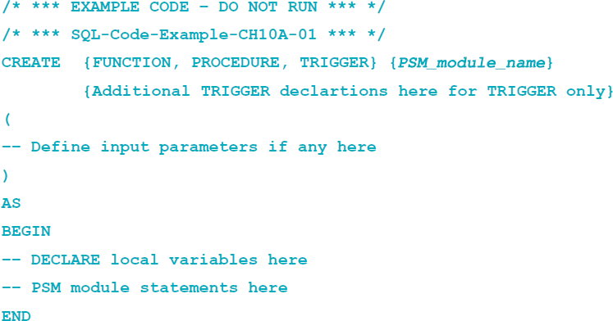
Application Logic: Basic SQL/PSM Structure

Slide 54
Application Logic: SQL/PSM Variables and Parameters
Transact-SQL identifies variables and parameters with an @ symbol.
Thus, WorkID is a column name, but @WorkID is a Transact-SQL variable or parameter.
A parameter is a value that is passed to a stored procedure when it is called.
A variable is a value used within a stored procedure or trigger itself.
Comments in Transact-SQL are either:
Enclosed in /* (slash asterisk) and */ (asterisk slash) signs.
Follow -- (two dashes) if they are restricted to one line.

Slide 55
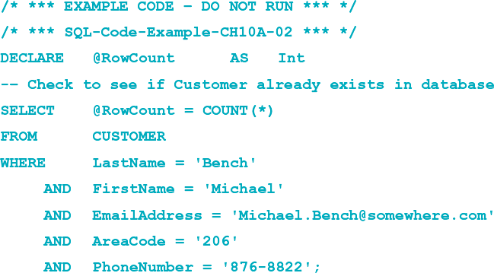
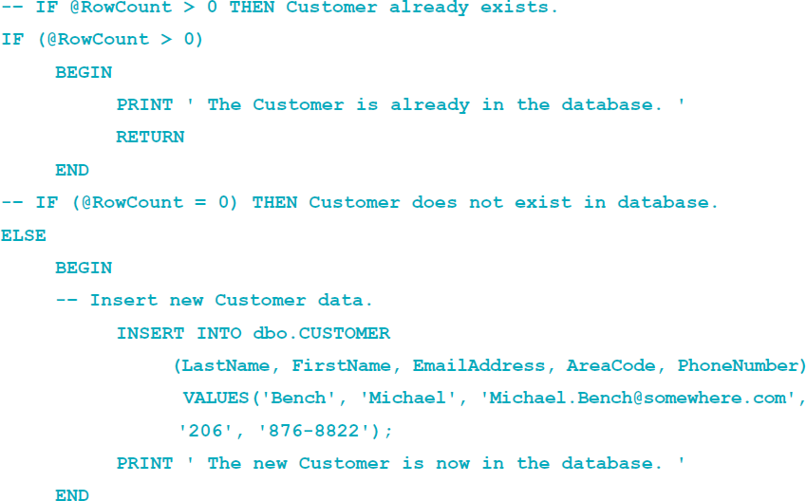
Application Logic: T-SQL Control of Flow Statements
IF…ELSE
BEGIN…END
WHILE
RETURN

Slide 56
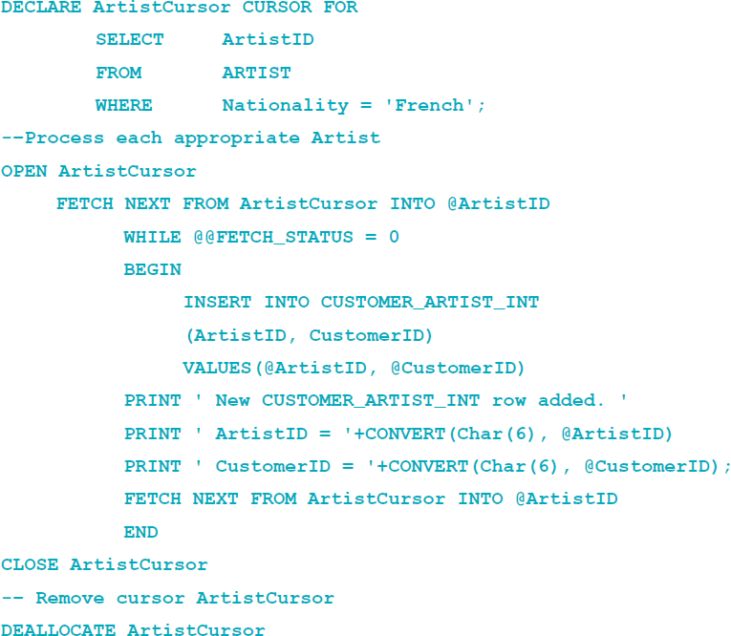
Application Logic: T-SQL Cursor Statements
DECLARE CURSOR
OPEN
FETCH
CLOSE
DEALLOCATE

Slide 57
Application Logic: T-SQL Output Statements
PRINT
CONVERT Function

Slide 58
SQL/Persistent Stored Modules (SQL/PSM)
SQL/Persistent Stored Modules (SQL/PSM) is an ANSI/ISO standard for embedding procedural programming functionality into SQL
Each DBMS product implements SQL/PSM in a different way, with some closer to the standard than others.
Microsoft SQL Server 2014 calls its version Transact-SQL (T-SQL).
Oracle Database 11g Release 2 calls its variant Procedural Language/SQL (PL/SQL).
MySQL 5.6 implements SQL/PSM, but has no special name for its variant of SQL.

Slide 59
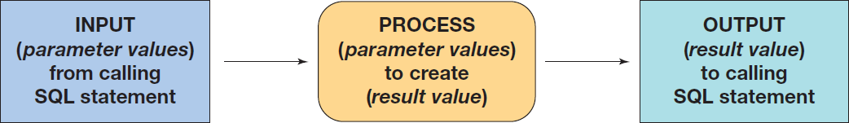
User-Defined Functions
A user-defined function (stored function) is a stored set of SQL statements that:
is called by name from another SQL statement
may have input parameters passed to it by the calling SQL statement, and
returns an output value to the SQL statement that called the function.

Slide 60
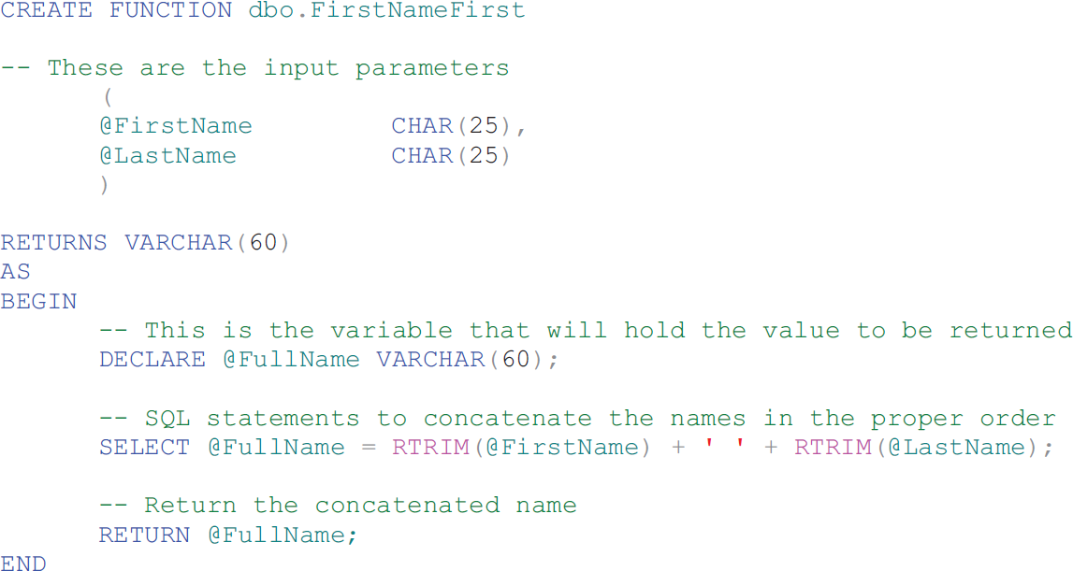
User-Defined Functions The FirstNameFirst Function I

Slide 61
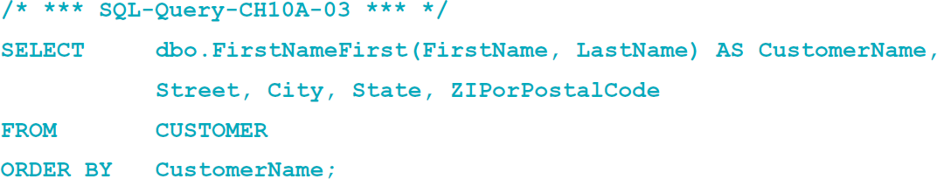
User-Defined Functions The FirstNameFirst Function II
Using the FirstNameFirst function:

Slide 62
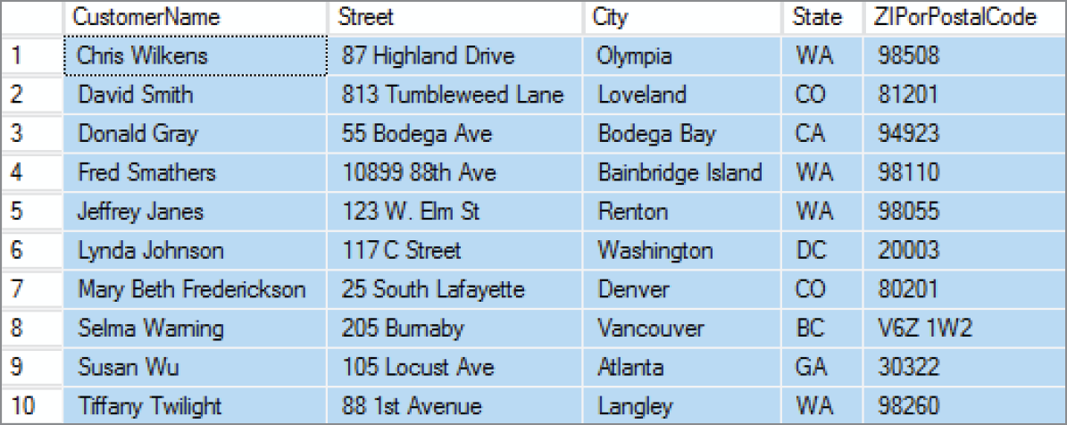
User-Defined Functions The FirstNameFirst Function Results

Slide 63
User-Defined Functions Additional Character String Functions
The CHARINDEX function returns the numeric position of a character:
The SUBSTRING function returns a specified subset of the characters in a character string:

Slide 64
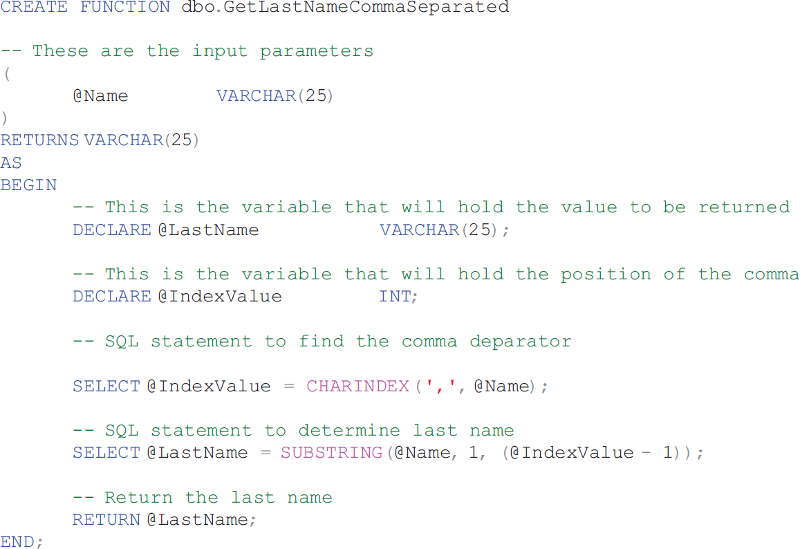
User-Defined Functions The GetLastNameCommaSeparated Function I

Slide 65
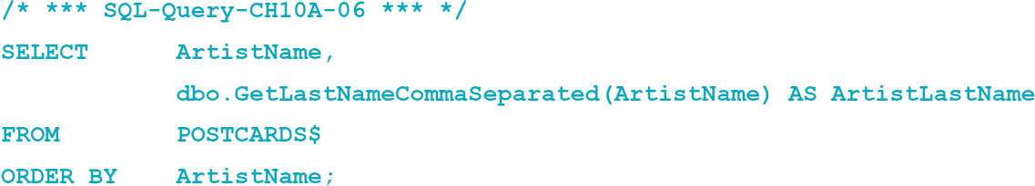
User-Defined Functions The GetLastNameCommaSeparated Function II
Using the FirstNameFirst function:

Slide 66
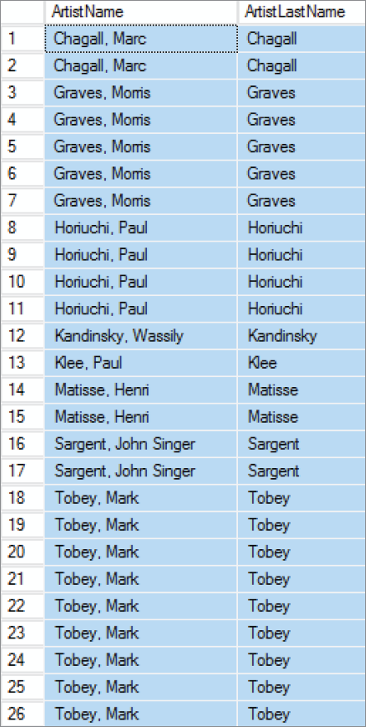
User-Defined Functions The GetLastNameCommaSeparated Function Results

Slide 67
Stored Procedures
A stored procedure is a compiled program stored within the database.
Transact-SQL surrounds basic SQL statements with programming constructs such as parameters, variables, and logic structures such as IF and WHILE.
Stored procedures are programs that can:
Have parameters.
Invoke other procedures and functions.
Return values.
Raise exceptions.
Creating stored procedures:
Write a stored procedure in a text file and process the commands using the Microsoft SQL Server Management Studio.

Slide 68
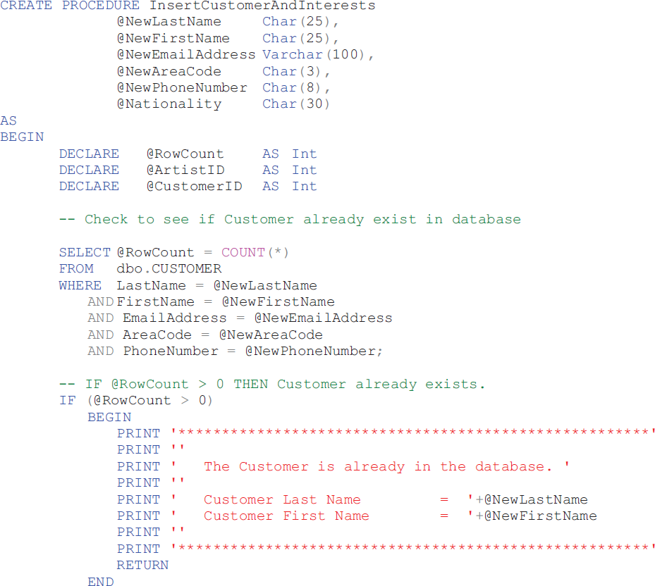

Slide 69
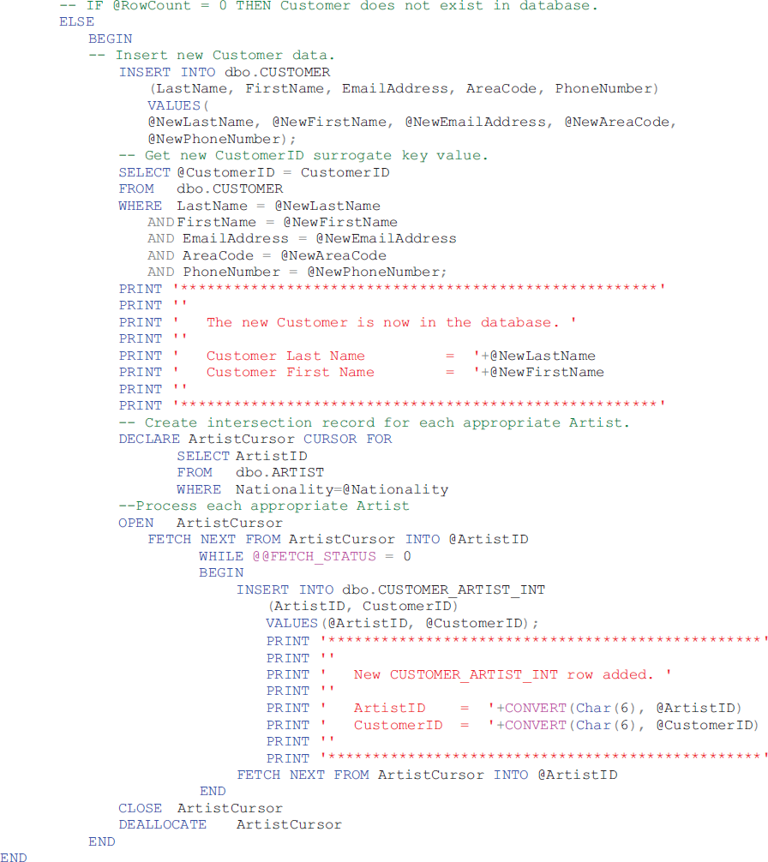

Slide 70

Running Stored Procedures

Slide 71
Triggers
An SQL Server trigger is a procedure that is invoked when a specified database activity occurs.
Triggers can be used to:
Enforce business rules.
Set complex default values.
Update views.
Implement referential integrity actions.
SQL Server only supports INSTEAD OF and AFTER triggers.
A table may have one or more AFTER triggers.
AFTER triggers may not be assigned to views.
A view or table may have only one INSTEAD OF trigger for each triggering action.
Triggers can roll back the transactions that caused them to be fired.

Slide 72

Triggers Comparison

Slide 73


Slide 74


Slide 75

Running Triggers

Slide 76
Concurrency Control
Three factors determine the concurrency control behavior of SQL Server.
Transaction isolation level
Cursor concurrency setting
Locking hints provided in the SELECT clause
Locking behavior also changes, depending on whether actions occur in the context of transactions or cursors independently.
Therefore, SQL Server places locks on behalf of the developer.
Locks may be placed at many levels of granularity and may be promoted or demoted as work progresses.

Slide 77

SQL Server Concurrency Options

Slide 78
SQL Server 2014 Security
SQL server provides two modes of authentication:
Windows only: the authentication is provided by the windows operating system.
Mixed security: SQL Server will accept either the windows-authenticated user name or it will perform its own authentication.

Slide 79

SQL Server 2014 Security Model

Slide 80

SQL Server 2014 Logins and Roles I

Slide 81

SQL Server 2014 Logins and Roles II

Slide 82

SQL Server 2014 Logins and Roles III

Slide 83

SQL Server 2014 Logins and Roles IV

Slide 84

SQL Server 2014 Logins and Roles V

Slide 85

SQL Server 2014 Logins and Roles VI

Slide 86
SQL Server Backup
SQL Server supports several types of backup:
A complete backup makes a copy of the entire database.
A differential backup makes a copy of the database changes since the last complete backup.
Differential backups are faster and can be taken more frequently.
Complete backups are simpler to use for recovery.
The transaction log also needs to be periodically backed up.

Slide 87
Database Recovery
Both data and log files are created by SQL Server.
SQL Server provides a wizard for setting up database maintenance plan, e.g., scheduling database and log backups.
To recover a database with SQL Server:
The database is restored from a prior database backup.
Log after images are applied to the restored database.
At the end of the log, changes from any transaction that failed to commit are then rolled back.

Slide 88

SQL Server 2014 Backup

Slide 89
SQL Server Recovery Models
Three recovery models:
Simple recovery: neither logging is done nor log records applied
To recover a database is to restore the database to the last backup.
This method can be used for a database that is never changed.
Full recovery: all database changes are logged
Bulk-logged: all changes are logged except those that cause large log entries

Slide 90

SQL Server 2014 Restore

Slide 91
David Kroenke and David Auer Database Processing Fundamentals, Design, and Implementation (14th Edition)
End of Presentation:
Chapter Ten A Part 2

Slide 92

All rights reserved. No part of this publication may be reproduced, stored in a retrieval system, or transmitted, in any form or by any means, electronic, mechanical, photocopying, recording, or otherwise, without the prior written permission of the publisher. Printed in the United States of America.

